Slide 1
Problem solving
Computational thinking
Top down
Bottom up

Slide 2
Last time
Computational thinking
There are two methods for creating solutions to problems:
Algorithms for problems that have clear steps in order to solve
Heuristics for problems where a more trial an error process is involved.

Slide 3
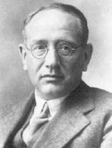
Polya’s Problem Solving Strategy
First principle: Understand the problem
Second Principle: Devise a plan
Third principle: Carry out the plan
Fourth principle: Look Back

Slide 4
today
Computational thinking
Top down decomposition
Bottom up

Slide 5
computational thinking
Students must be able to apply problem solving skills
Analyse problems
Identify solutions
Develop solutions into computer programs
You will be expected to solve realistic problems that may form a complete solution or a sub-part of a larger program.

Slide 6
Top down
It is a software development technique that imposes a hierarchical structure on the design of the program.
Define the solution at the highest level of functionality
Split it down further
… and further into small routines
These can be easily documented and coded.

Slide 7
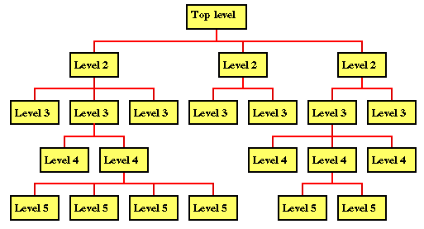
?
?

Slide 8
Problems
The designer ends up with very large tree structures.
There is no clear identification of the flow of control.
It is difficult to represent constructs such as selection, repetition and routine invocation.

Slide 9
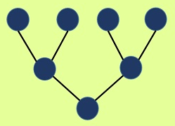
Bottom up
Bottom-up developing is a type of software development process that is based on using incoming data from the environment to form a perception.
For example if thinking about the human body sensory input is given through the eyes, which is then converted by the brain into a bigger picture that we see

Slide 10

Top down vs bottom up
Building a bridge
It doesn’t make sense to make a little part of the bridge, then build the rest of it around that part.
We know what the solution will look like. We have experience from past projects.

Slide 11


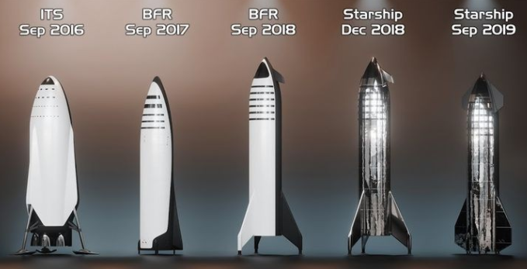
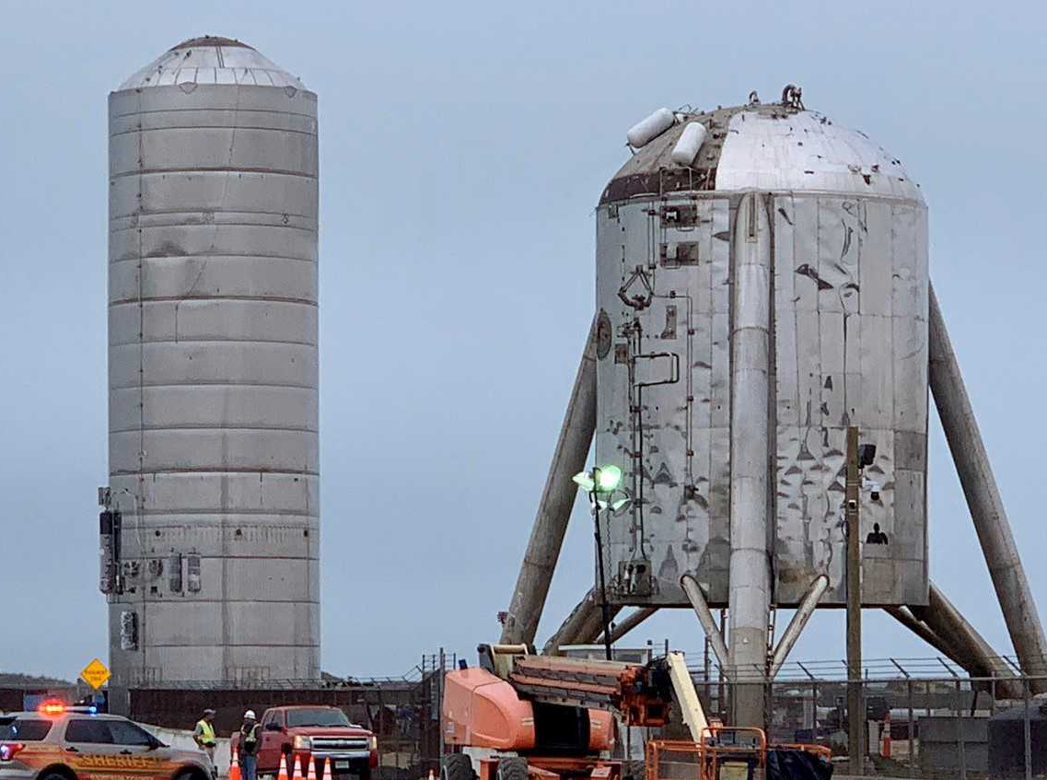
Top down vs bottom up
They don’t know what the final product will look like.
But they do know (more or less) what components are needed

Slide 12

https://www.youtube.com/watch?v=bjcyDZ7zbIA

Slide 13
Worksheet 04 – top down vs bottom up
Complete the worksheet
Create poster (random.org)
Check worksheet progress
Pair programming

Slide 14
Making dinner – top down, create the elements - all the bits come together to make the meal at the end
Creating a new board game – prototyping, testing, feedback. End result is not exactly what you thought.

